Slide 1
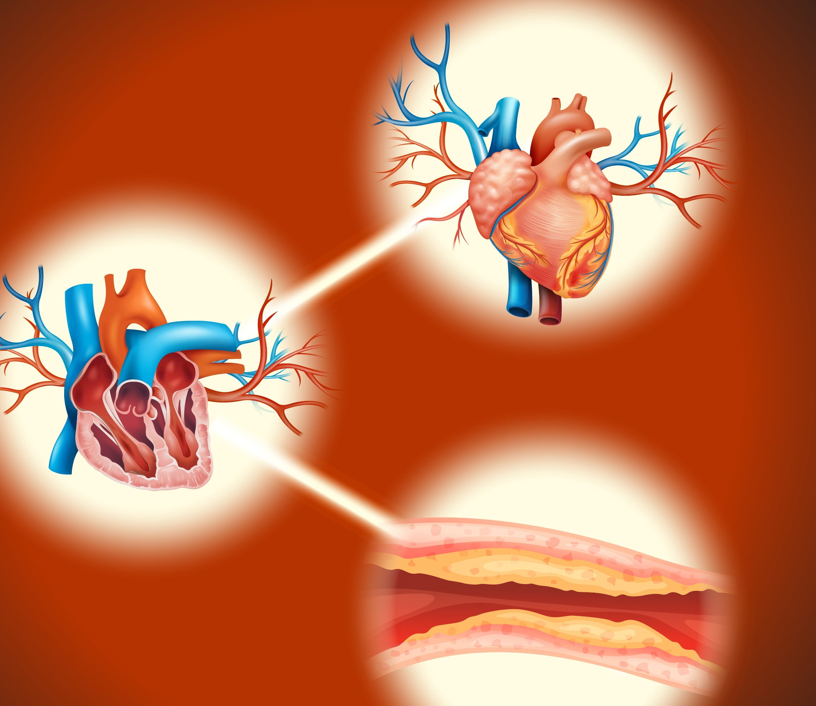
Heart Disease

Slide 2
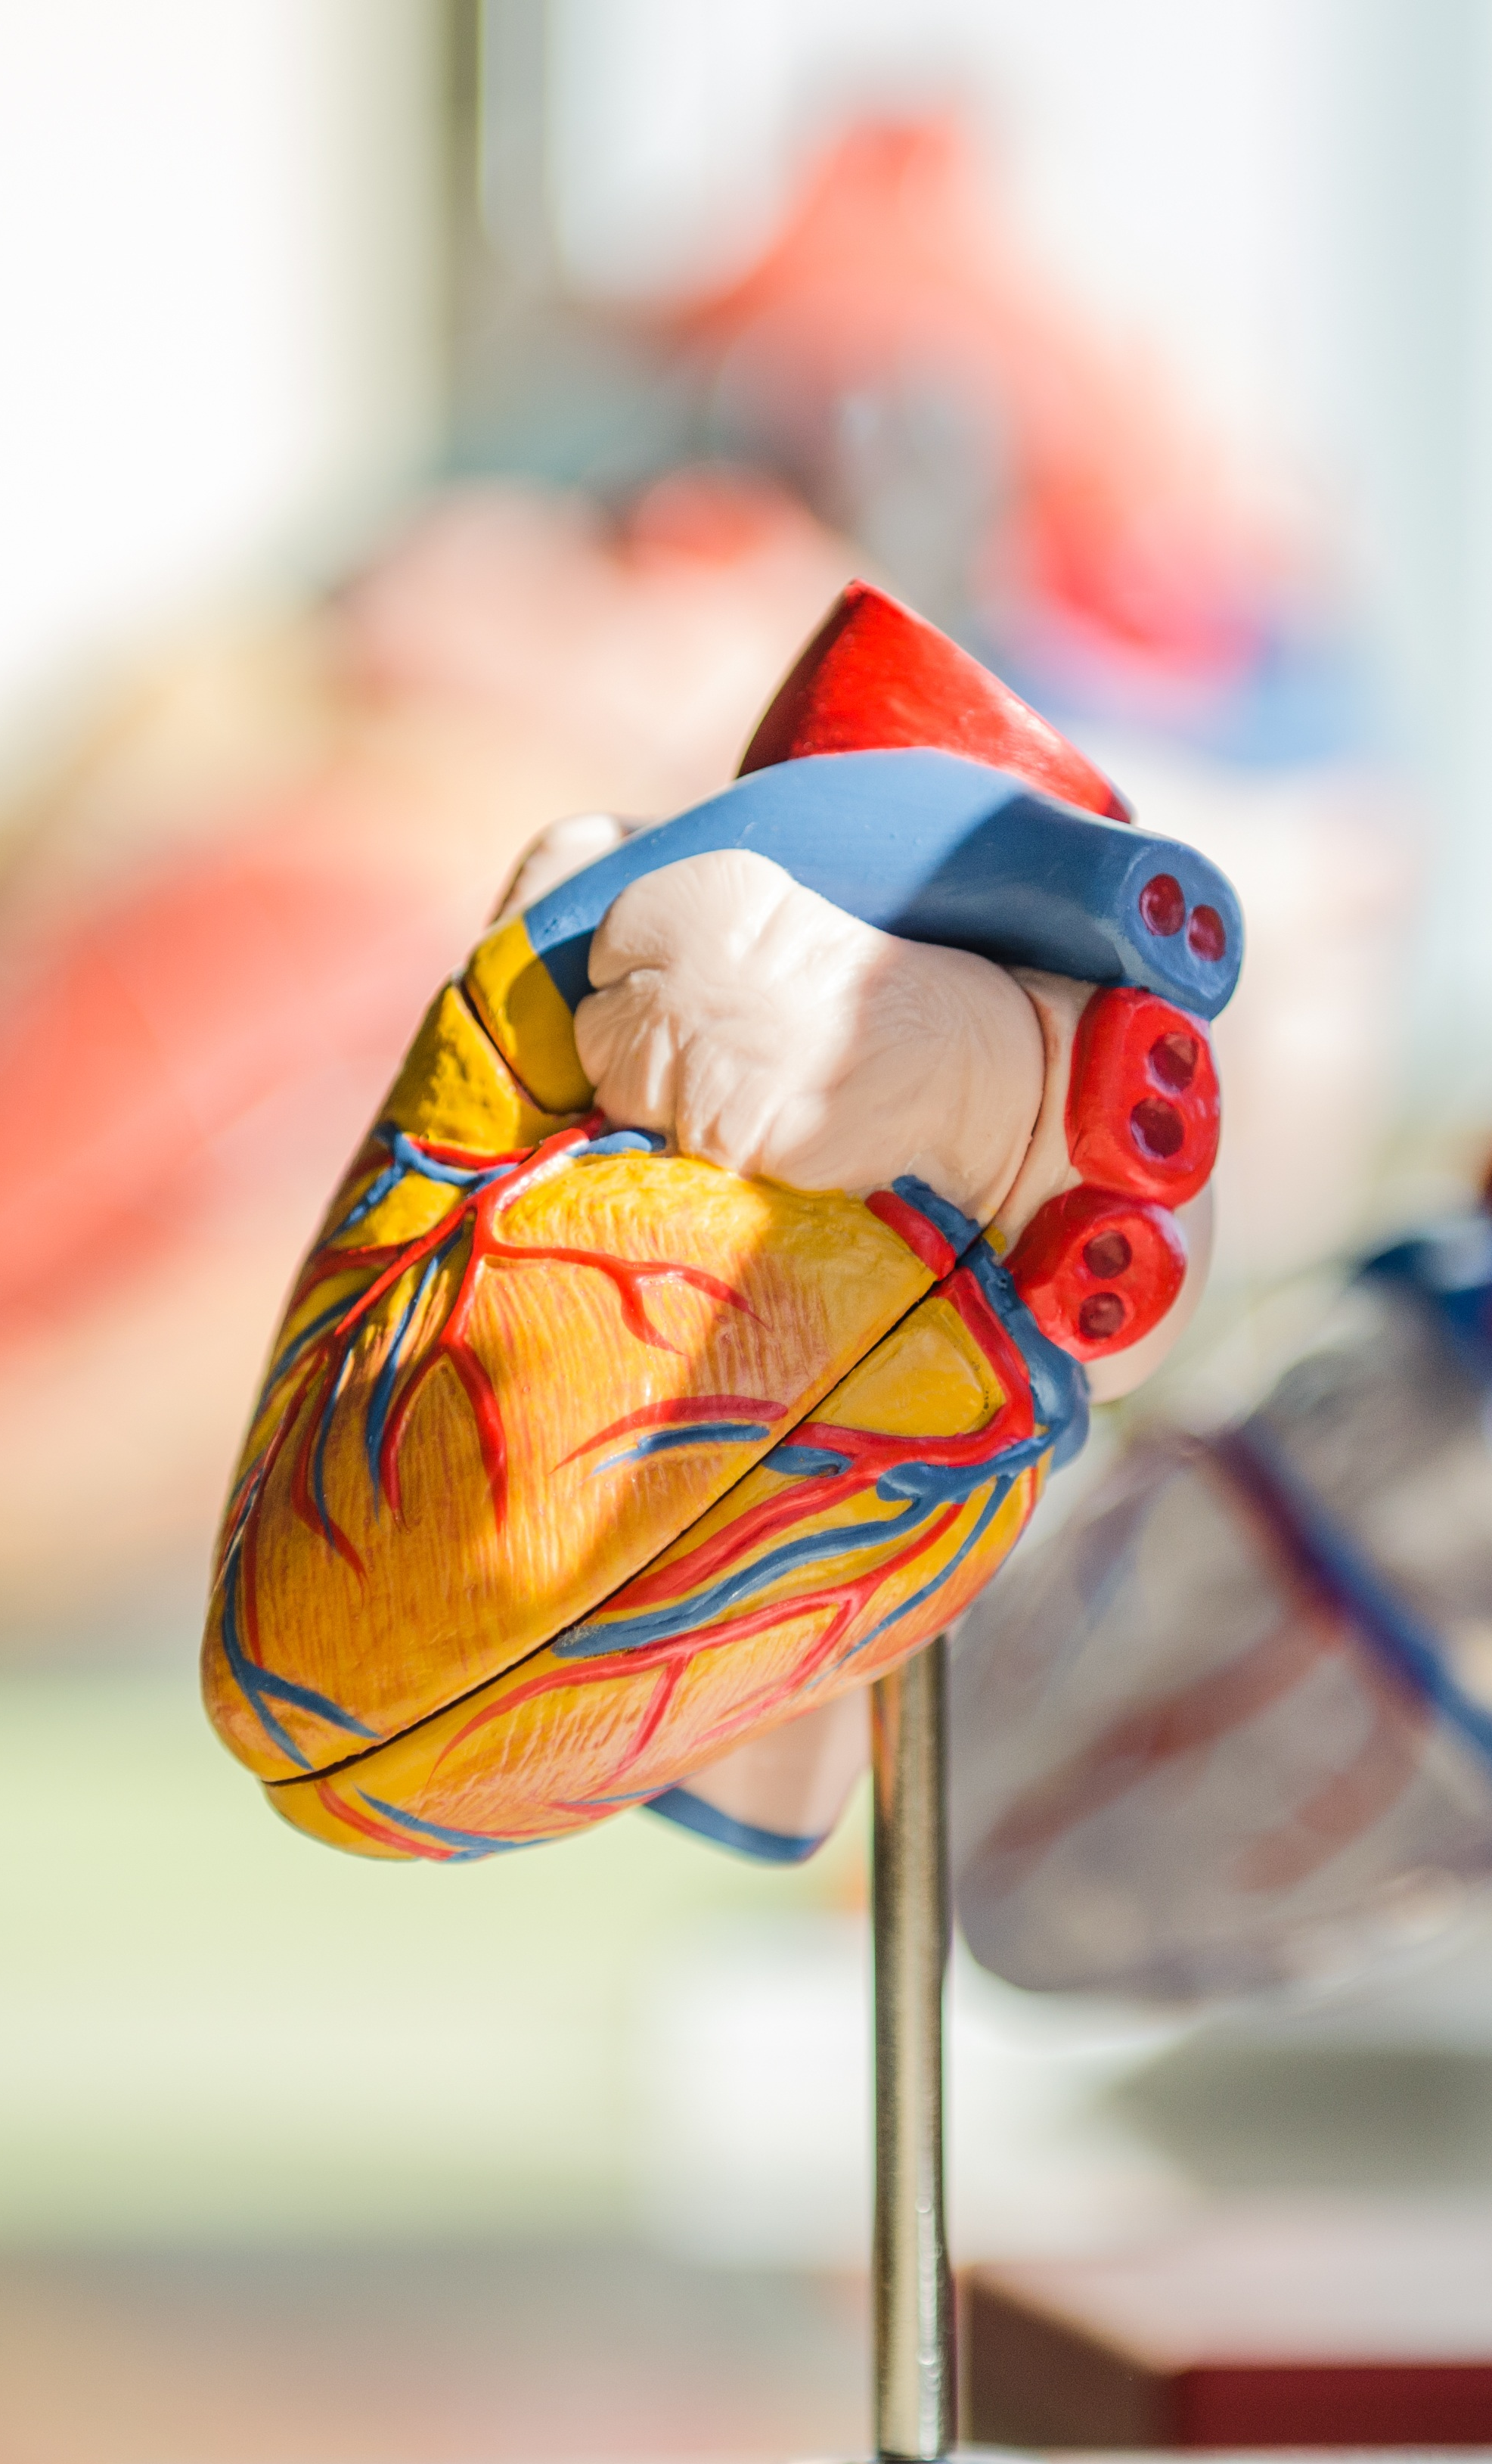
Introduction
Heart disease is the top cause of death in the United States. In 2021, heart disease caused 1 in 5 deaths, nearly 700,000 people (Cleveland Clinic).
Heart disease includes many diseases that affect your heart, but coronary artery disease (CAD) is the most common and familiar one. CAD can create a waxy buildup in your heart’s arteries that can cause a heart attack (Cleveland Clinic).
A heart attack occurs when the blood flow to a part of the heart is blocked by a blood clot. If this clot cuts off the blood flow completely, the part of the heart muscle supplied by that artery begins to die.(American Heart Association).
Symptoms include chest pain or discomfort, upper back or neck pain, heartburn, nausea or vomiting, extreme fatigue, dizziness, and shortness of breath (CDC).
The relevance of risk factors and methods of prevention vary from study to study. These inconsistencies motivated us to learn more about heart disease

Slide 3

Dataset Source
The dataset consists of heart disease risk factors, lifestyle indicators, demographic indicators, location information, Covid status, and other variables gathered from the 2022 annual CDC survey of more than 400,000 adults related to their health status.
The data contained in the dataset was obtained through the Behavioral Risk Factor Surveillance System (BRFSS), which conducts annual telephone surveys to collect data on the health status of US.
The author of this updated dataset reduced the nearly 300 original variables down to 40, making it much easier to group data for analysis.
We discovered the dataset via Kaggle.com.
Below is the link to the dataset. Make sure to check it out! ☺
Indicators of Heart Disease 2022

Slide 4

Data Exploration & Cleanup Process
Once selected, the group discussed the contents of the dataset. Each member of the group selected the data that they found most interesting and would help answer one of our group questions.
The remaining columns, which were unnecessary for our analysis, required cleaning. Examples of these are 'Removed Teeth', "Deaf/Hard of Hearing', 'Blind/Vision Difficulty', etc.
The final step of the cleanup process was executed in Jupyter Notebooks, where data was reduced to specifically aid in answering our individual questions.
This processes can be followed step-by-step in our repository below:
GitHub Respository

Slide 5

Analysis Process: Questions we will attempt to answer in our project
Summer:
What is the relationship between key ‘lifestyle’ indicators and heart disease?
Sonu:
How prevalent is heart disease in male vs female?
Dylan:
Which locations have the highest/lowest incidence of heart disease?
Nolan:
Is Covid-19 connected to heart disease? What are the effects?
This Photo by Unknown author is licensed under CC BY-SA.

Slide 6
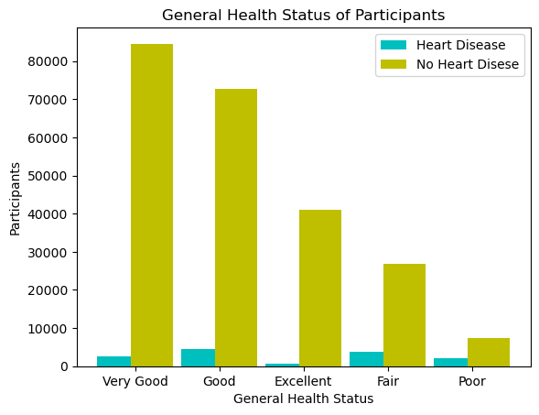
Lifestyle Indicators: General Health

Slide 7
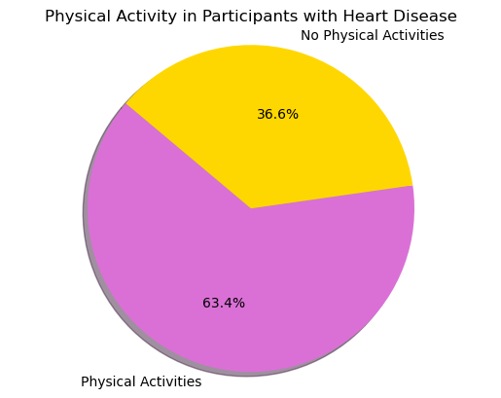
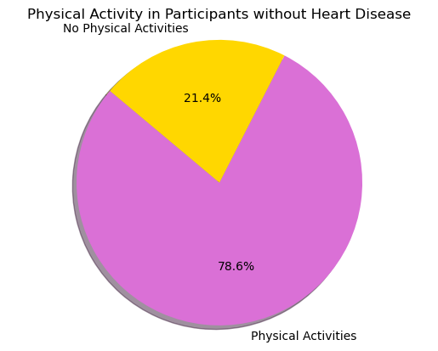
Lifestyle Indicators: Physical Activity

Slide 8
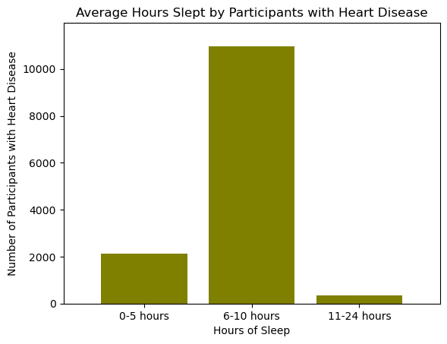
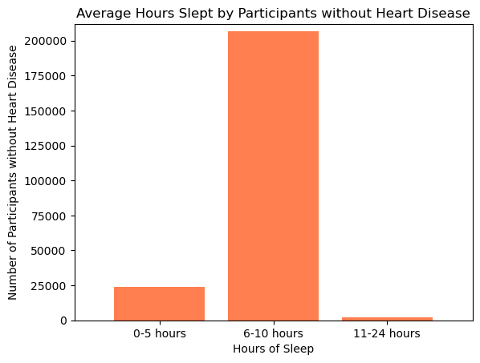
Lifestyle Indicators: Sleep

Slide 9
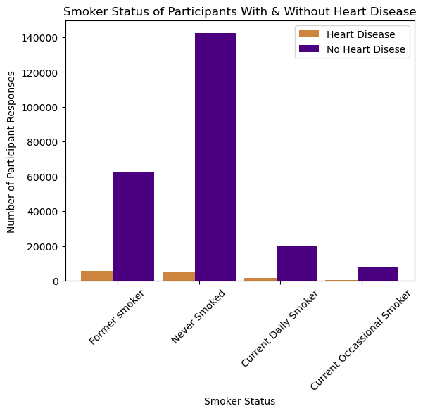
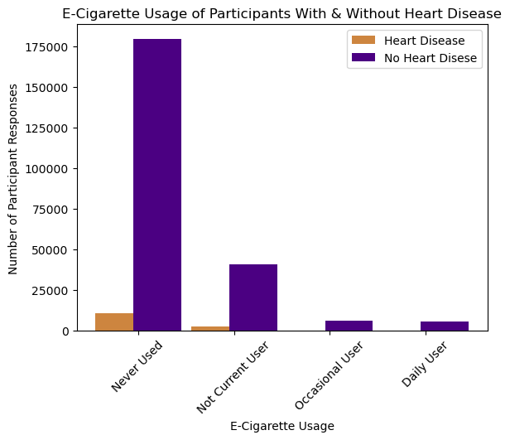
Lifestyle Indicators: Smoking & E-cigarette Usage

Slide 10
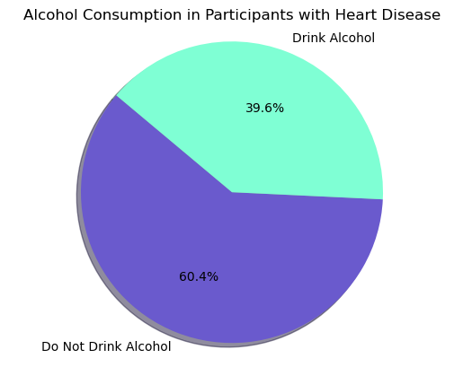
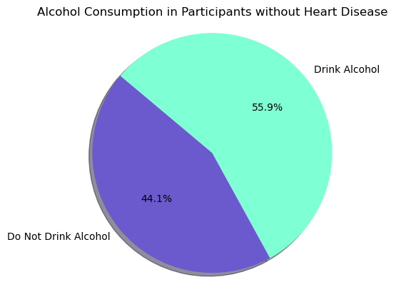
Lifestyle Indicators: Alcohol Consumption

Slide 11
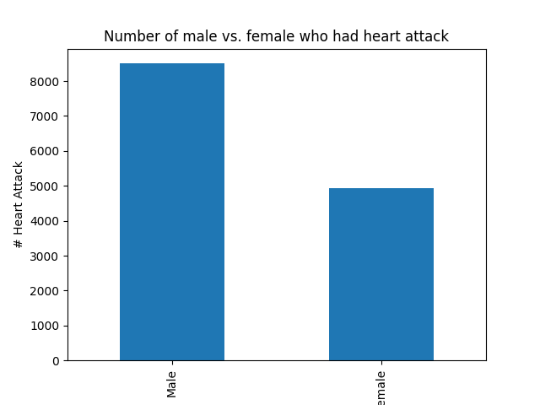
Heart Disease – Male vs. Female - Numerical Conclusion
Out of 13,435 total number of heart attacks there are 8503 males and 4932 are females.

Slide 12
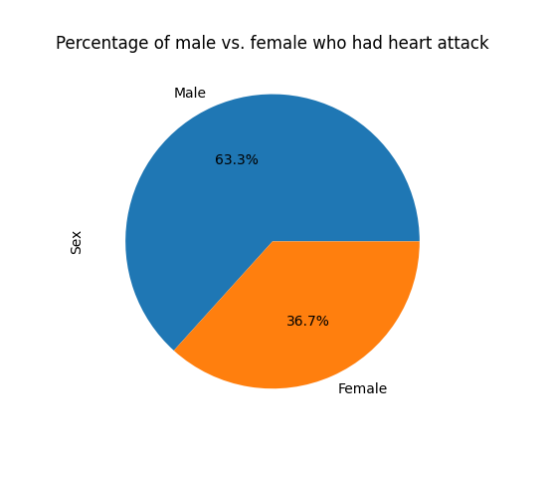
Heart Disease – Male vs. Female - Visualization Summary
Out of all heart attack cases, 63.3% were in male and only 36.7% in female.​

Slide 13
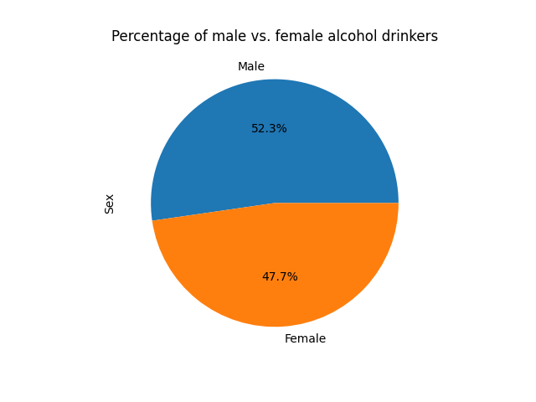
Male vs. Female – Alcohol Drinkers
Of all alcohol drinkers 52.3 are male and only 47.7% are female.

Slide 14
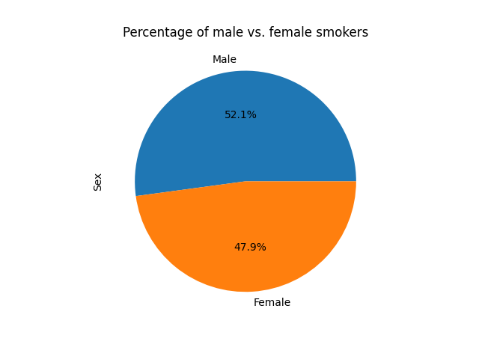
Male vs. Female – Smoker Status
Of all patients who were smoker in past or still smoke 52.1% were male and 47.9% were female.

Slide 15
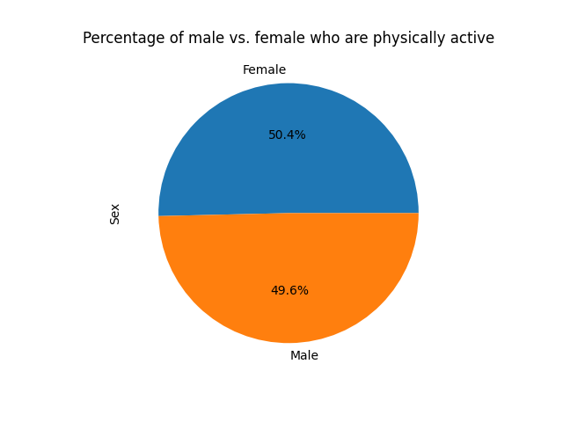
Male vs. Female – Physical Activity
Of all the patients females are slightly more active than males.

Slide 16
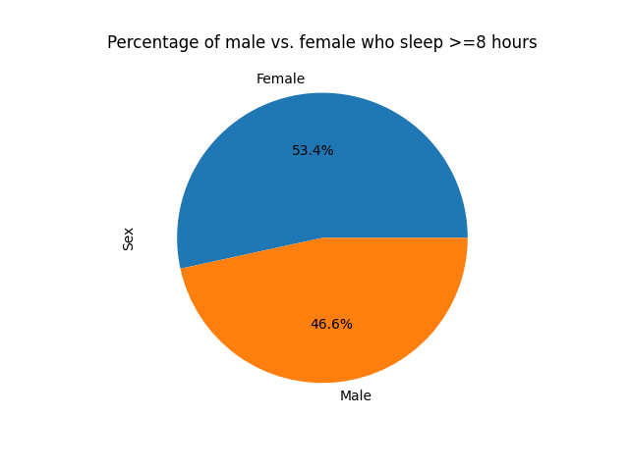
Male vs. Female – sleep >= 8 hours
Of all patients 53.4 females sleep for 8 or more hours, whereas only 46.6% male sleep for 8 hours or more.

Slide 17
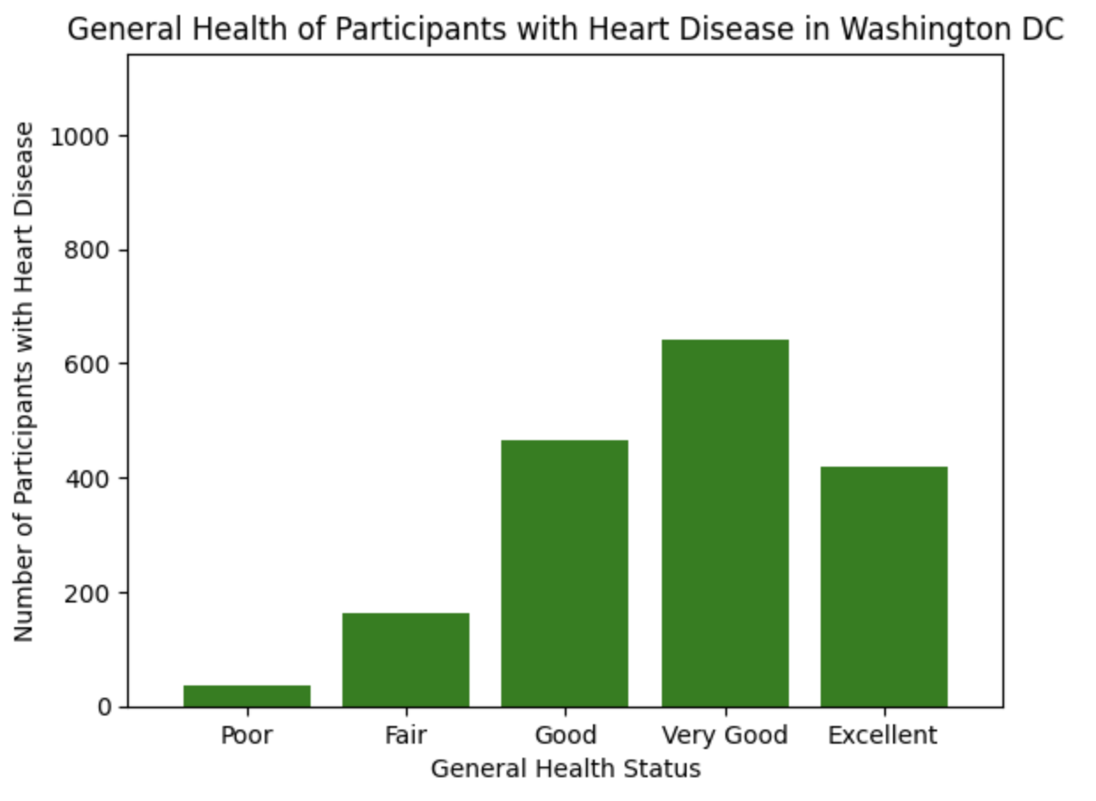
Location Indicators: Well-Being

Slide 18
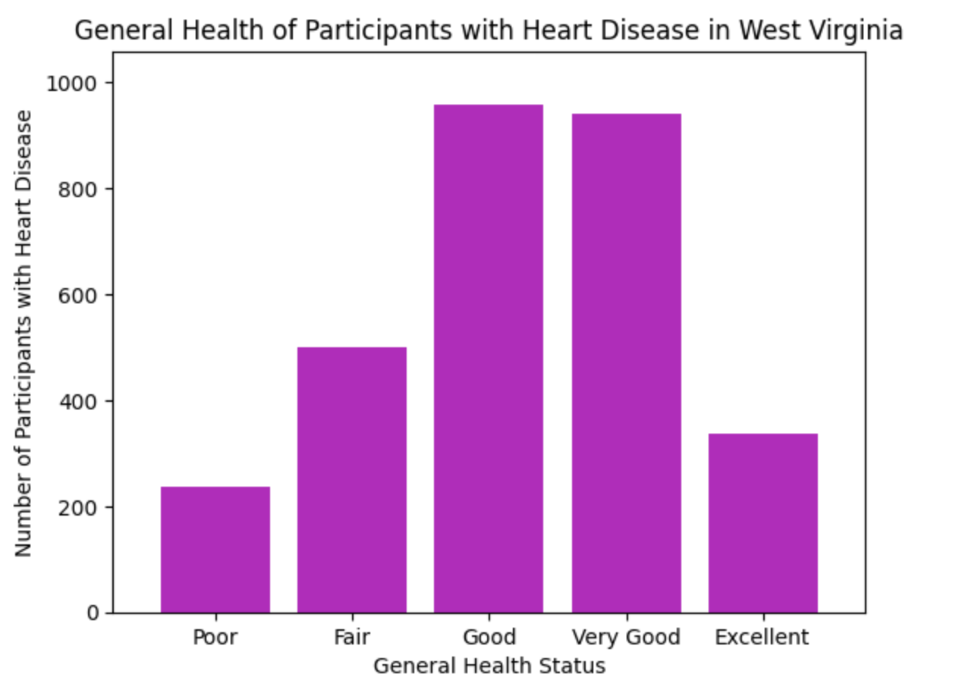
Location Indicators: Well-Being

Slide 19
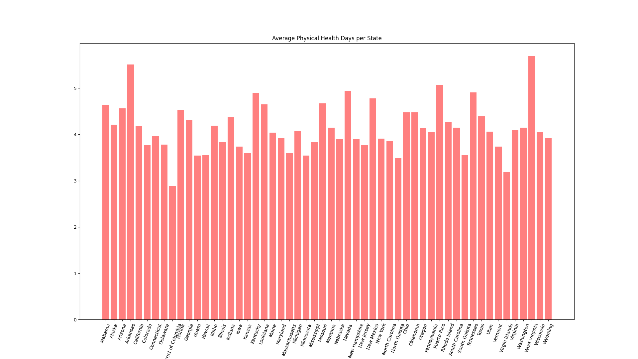
Conclusion Visualization Summary

Slide 20
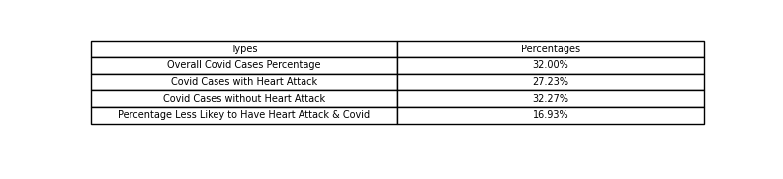
Covid Numerical Summary by Nolan
While we didn't find too much supporting data, we non-the less have had some interesting findings with covid, it seems we are ~17% less likely to have had Covid and an Heart Attack.

Slide 21
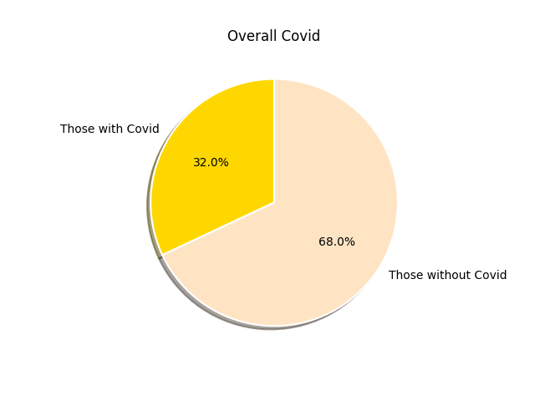
Covid Visualization
This gives you an idea of the overall covid afflictions on the entire dataset

Slide 22
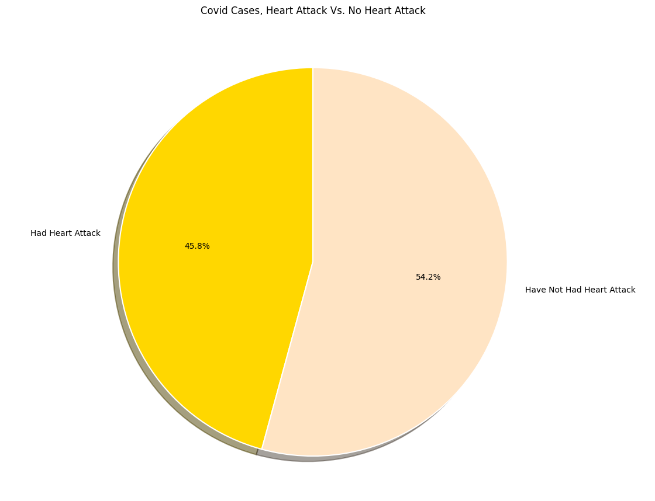
Conclusion Visualization Summary by Nolan
Additionally, here is a pie graph covid cases who've had had a heart attack, and who've hadn't had one.

Slide 23

Implication of Findings
While we can't come to any great conclusions, we can safely say that Covid most likely does NOT have an effect on heart health.
Based on our findings rate of heart attack in males is higher than females.
People with heart disease do not feel their general health is great.
Physical activity has a significant role to play in preventing heart disease.
Sleep does not impact the chances of a person having heart disease.
Smoking increases the risk of heart disease slightly while e-cigarettes are not as much of a risk factor.
Alcohol consumption does not significantly increase the risk of heart disease.

Slide 24

References
American Heart Association. “About Heart Attacks.” Www.heart.org, 31 July 2016, www.heart.org/en/health-topics/heart-attack/about-heart-attacks. Accessed 16 May 2024.
CDC. “About Heart Disease.” Heart Disease, 29 Apr. 2024, www.cdc.gov/heart-disease/about/index.html. Accessed 16 May 2024.
Cleveland Clinic. “Heart Disease: Symptoms, Risk Factors & Treatment.” Cleveland Clinic, 1 Sept. 2022, my.clevelandclinic.org/health/diseases/24129-heart-disease. Accessed 16 May 2024.

